Slide 1
Philosophy of Science
Francesco Di Iorio
francedi.iorio@gmail.com
185 5166 1135

Slide 2
According to the empiricist/positivist view, the facts on of science (which are statements that describe the reality) have three features:
(a) Facts are directly given to observers via the senses
(b) Facts are prior to and independent of theory
(c) facts constitute a firm and reliable foundation for scientific knowledge

Slide 3
Positivists: the observational basis of science allow us to establish certain truths
This view is problematic: one of the reasons for this is that knowledge is interpretation (the same facts can be interpreted in different ways)
The fact that knowledge is interpretation has an important consequence:
If the a priori knowledge that provides the categories we use to do our observations is wrong, the meaning we attach to the observed facts is similarly wrong

Slide 4

Galileo’s ship experiment

Slide 5
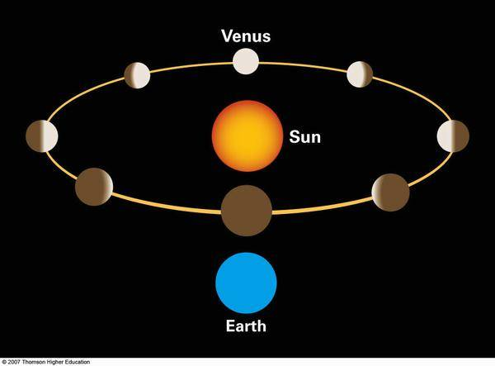

Slide 6
Chapter 2
Chapter 2 is about a problem related to the criticism of empiricism and positivism
If perception is subjective interpretation because it is influenced by the individual background (e.g. cultural factors, personal history), how can we understand if a fact is objectively valid?
In other words, if people interpret reality in different ways, how can we find an agreement about what must be regarded as objective truth? How can we make a difference between subjective opinions and scientific truth?

Slide 7

Moon illusion

Slide 8


Slide 9
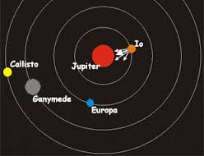
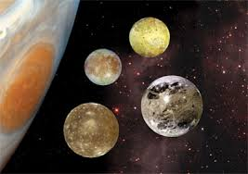
The Galilean moons

Slide 10
Objective, but fallible facts
The basis for scientific knowledge is both objective and fallible
It is objective insofar as it can be publicly tested by straightforward procedures, and it is fallible insofar as it may be undermined by new kinds of tests (made possible by advances in science and technology)
A fact can be regarded as objective truth if everybody can test its validity empirically and if tests done in the past confirmed that the fact is true

Slide 11
E.g.
“Every creature is bound to decay and die”
This statement has been “refuted by the discovery that bacteria are not bound to die, since multiplication by fission is not death”
The multiplication by fission is a method of asexual reproduction that involves the splitting of a parent cell into two approximately equal parts

Slide 12
Chapter 3: Facts and Experiments
What is needed in science is not just facts but relevant facts: facts are infinite (which facts are relevant and which are not relevant to a science depends on the current state of development of that science)
Facts that constitute the basis for science come often in the form of experimental results
An experiment presupposes control: there are many variables; scientists need to try to isolate the effects of a specific variable to see if that variable is the cause of the phenomenon under investigation

Slide 13
The relevance of experimental results depends on the theoretical context
E.g. measurement of the molecular weights of chemical elements and compounds
The fact that experiments are correctly performed it is a necessary but not sufficient condition for the acceptability of experimental results as valid scientific contributions
Experimental results can be rejected as inadequate not only because it can be understood that the experiment was not adequately performed, but also because the experiment can be understood as incapable of solving the problem in hand

Slide 14
The circularity problem
The validity of the theory is showed by experiments and the validity of the experiments depends on the theory
How can science settle a dispute between the proponents of opposing theories by using experimental results?
X defends her theory because of the experimental result z, Y defends her theory because of the experimental result w, who is right?
According to Chalmers, this is not a problem because of two reasons:
(i) all experiments presuppose the validity of the theory they test plus the truth of other theories : since the presupposed theories are not identical to the theory under test, there is no circularity (we can criticize the validity of the tested theory independently of the experiment, i.e. by criticizing the others theories)

Slide 15
(ii) the results of an experiment are largely determined by the world and not by the theories (experimental tesult does not depend solely on our theoretical assumptions)
We cannot make the outcomes conform to our theories
The history of science gives us many examples of cases where the experiments helped us to understand things better (e.g. vaccines)

